Slide 1
Praktikum Desain PL
Margareta Hardiyanti, S.Kom., M.Eng
Divi Galih Prasetyo Putri M.Kom., Ph.D

Slide 2
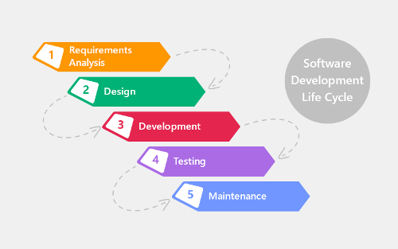
Tahapan Pembangunan PL

Slide 3
Requirement Analysis
Interview
Observation
Questionaire

Slide 4
Interview
Tipe – tipe interview
Structured interview
Unstructured interview
Semi-structured interview

Slide 5
Question Type
Open-ended question
Close-ended question

Slide 6
Communication Principles
Sebagai representative dari development team yang ikut mengambil bagian dalam interview terdapat beberapa communication principles yang harus dipahami dan dilakukan, antara lain :
Prepare yourself
Listen to the client
Have a facilitator and take notes
Best face to face

Slide 7
General Interview Guidelines
Perencanaan Interview
Pelaksanaan Interview
Analisis hasil

Slide 8
Personas
Personas are rich descriptions of typical users of the product under development on which the designers can focus and for which they can design products. (Cooper, 1999)

Slide 9
Persona goals
A persona has two goals (Caddick and Cable, 2011):
• To help the designer make design decisions • To remind the team that real people will be using the product

Slide 10
Personas describes
A model of users
Not real but based on real data
Describe a group of users
What they want to accomplish
What are their motivations
How they behave
How they think
Inform the product design
Ideation
Validation of design concepts

Slide 11
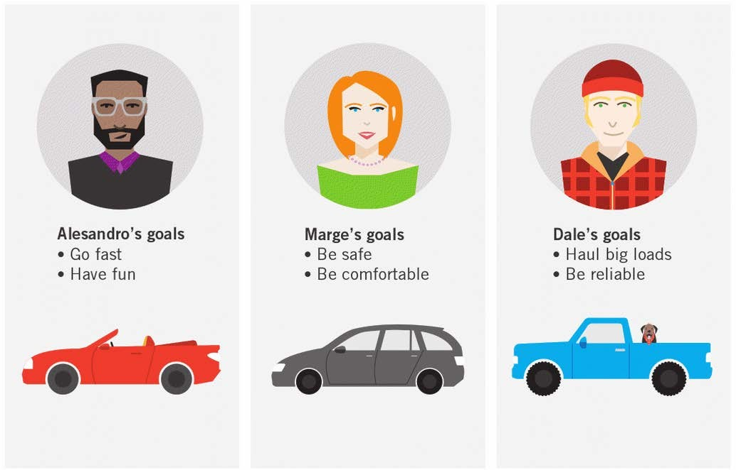
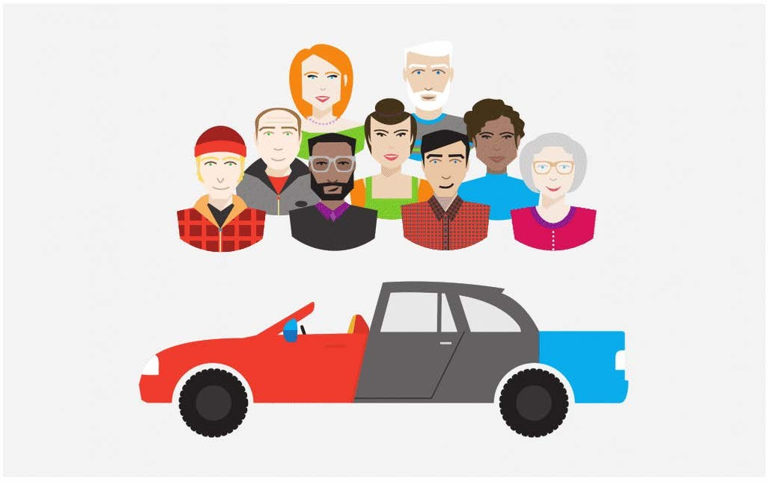
Choosing your audience
Cooper, 2014 – Ch. 3

Slide 12
Choosing your audience
Choose right individuals to design for
Represent the needs of large groups & prioritise their needs
If possible satisfy secondary users

Slide 13
Strengths of personas
Determine what the product should do and how it should behave
For discussion with stakeholders – simple
User testing
Marketing tools
Avoid
Designing for a generic user
Developer’s goals

Slide 14
Personas are not…
SWEN90009: Software Requirements Analysis – By Alexi Lopez-Lorca – Semester 1 2018, Week 3 – © University of Melbourne 2018
Not an average user
Exemplary or definite behaviour within the range
E.g. make between $50k-$70k
Not the result of the developers’ biases and assumptions

Slide 15
Persona includes
Description of the user’s behavior, key goals, attitudes, activities, and environment.

Slide 16
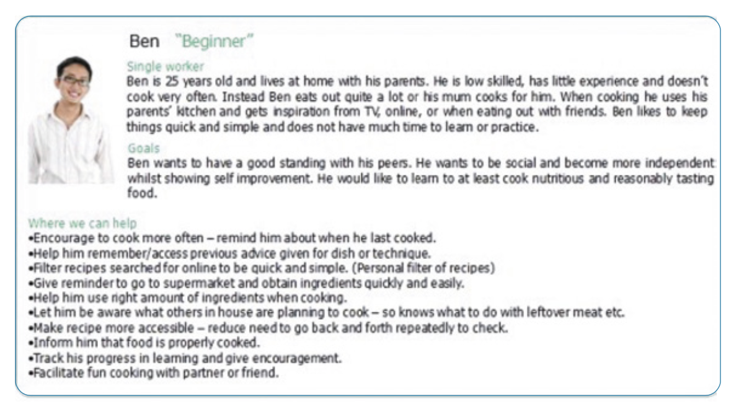
Sample of Persona

Slide 17
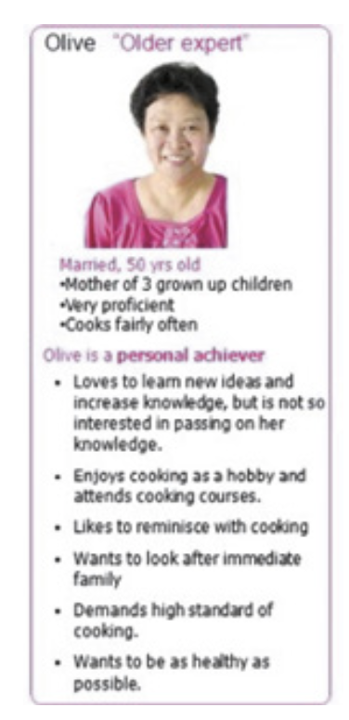
Sample of Persona

Slide 18
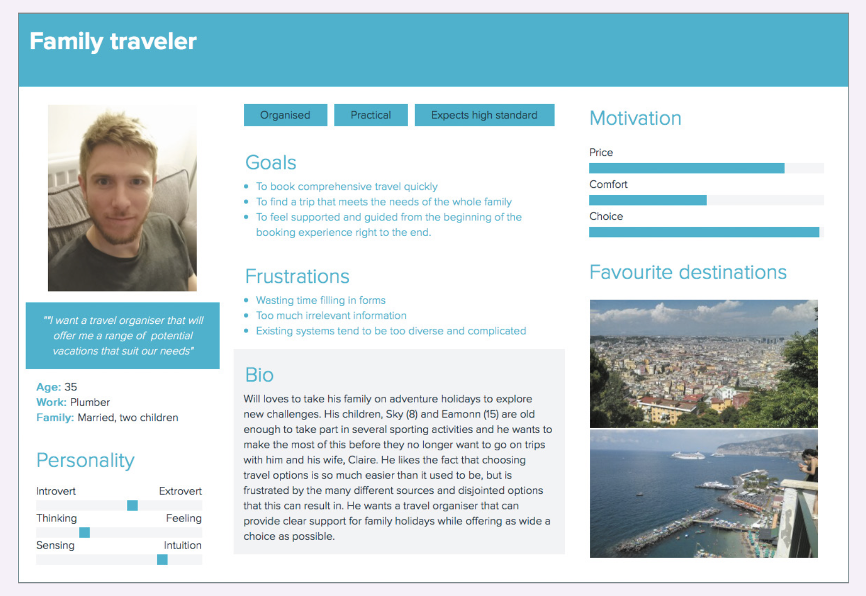
Sample of Persona

Slide 19
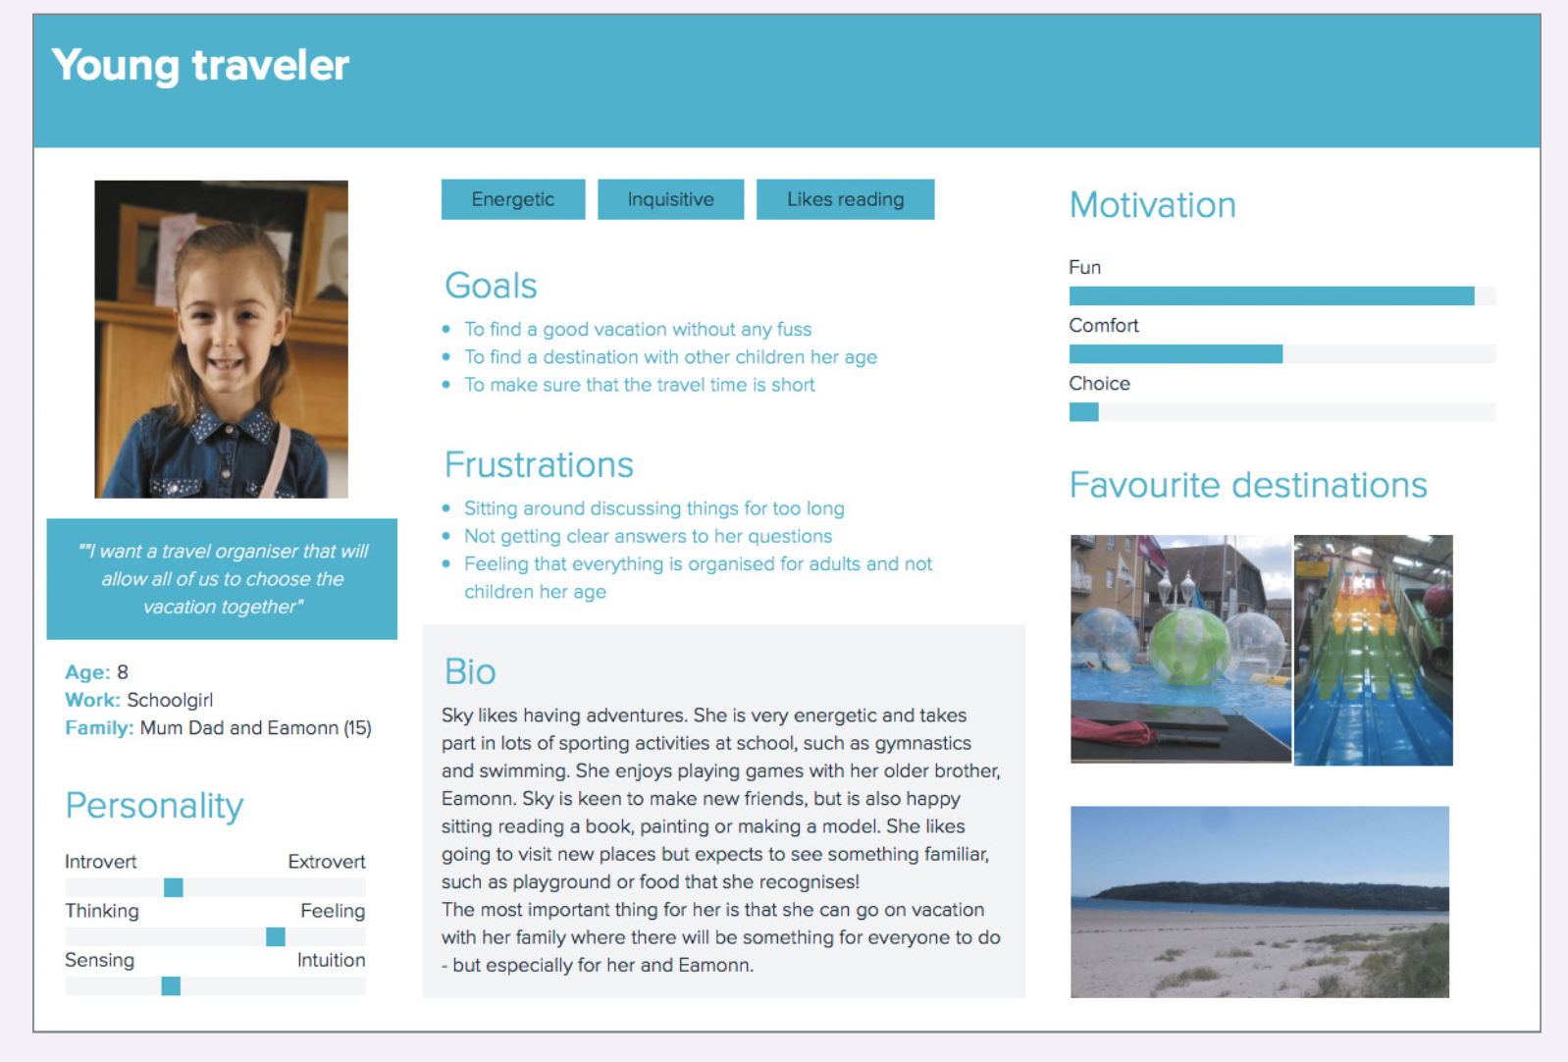
Sample of Persona

Slide 20
How to use Persona
“What would Nick (persona 1) do in this situation with the product?”
and
“How would Steve (persona 2) respond if the product behaved this way?”

Slide 21
Studi kasus 1
Minimarket milik Pak Joko menjual mulai peralatan rumah tangga , alat tulis, dan barang kelontong untuk kebutuhan sehari-hari. Seiring dengan berkembangnya bisnis Pak Joko, ia dan karyawannya mulai kewalahan untuk melakukan pembukuan transaksi secara manual. Selain itu, Pak Joko juga ingin memberikan pelayanan maksimal pada pelanggannya dengan selalu menyediakan barang - barang yang pelanggan butuhkan.

Slide 22
Studi kasus 1
1. Buatlah pertanyaan interview yang relevan : (15 mins)
2. Develop persona berdasarkan hasil interview anda

Slide 23
Thank you!

